Slide 1
SS ZG653: Software Architecture Lecture 11: Distributed and Interactive Systems
Instructor: Prof. Santonu Sarkar
February 25, 2015

Slide 2
Broker Pattern
Distributed Systems

Slide 3
Context
Complex environment comprises of distributed systems
You want to take advantage of computing power of many CPUs, or a cluster of low-cost systems
A software may be available only on a specific computer
Due to security reasons, you want to run different parts in different systems
Some services are provided by business partners over the internet

Slide 4
Problem with distributed components
To build a complex sw system as a set of decoupled, interoperating components rather than a monolith.
Greater flexibility, maintainability, changeability
Partitioning into independent components makes system distributable and scalable.
Require a flexible means of inter-process communication
If participating components handle communication, there can be several issues
System depends on which communication mechanism used
Clients need to know location of servers

Slide 5
Forces
It should be possible to distribute components during deployment– application should unaware of
Whether the service is collocated or remote
If remote, where the location of the server is
Need to exchange, add, or remove components at run-time
Must not depend on system-specific details to guarantee portability and interoperability
Architecture should hide system-specific and implementation-specific details from users of components and services
Specifically communication issues, data transfer, security issues
Notes:
Previous slide is about inter-process communication.
The above are additional services needed.

Slide 6
Broker Pattern: Solution
Introduce a broker component to achieve better decoupling of clients and servers
Servers: register themselves with the broker and make their services available to clients through method interfaces.
Clients: access the functionality of servers by sending requests via the broker
The Broker:
Locating the appropriate server and forwarding a request to that server
Transmitting results and exceptions back to the client
Notes:
Application accesses distributed services by sending message calls to the appropriate object.
Does not need to focus on low-level inter-process communication.
Broker architecture is flexible
Allows dynamic change, addition, deletion, and relocation

Slide 7
Broker Pattern: Solution -- 2
Reduces the development complexity
Introduces object model where distributed services are encapsulated within objects.
Broker systems offer a path to the integration of two core technologies:
Distribution
Object oriented design
Object oriented design from single applications to distributed applications that can
run on heterogeneous machines and
written in different programming languages.
Notes:
Application accesses distributed services by sending message calls to the appropriate object.
Does not need to focus on low-level inter-process communication.
Broker architecture is flexible
Allows dynamic change, addition, deletion, and relocation

Slide 8
Broker Pattern: Structure
Participating components
Clients
Servers
Brokers
Bridges
Client-side proxies
Server-side proxies
Notes:
6 pages on “structure”

Slide 9
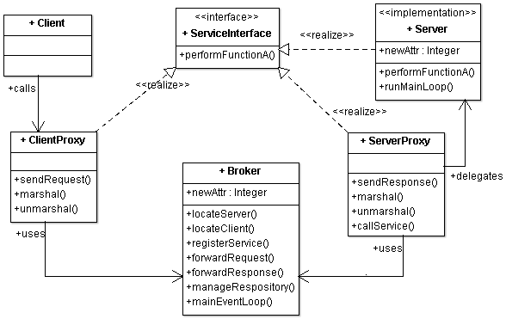
Broker
Necessary abstraction that makes distribution possible by providing the contract about the service that the server is going to provide without exposing the implementation details on the server side
Process 1
Process 2
Process 3

Slide 10
Broker pattern: Implementation
Define an object model or use an existing one
Decide which kind of component-interoperability the system should offer
Specify the APIs the broker component provides for collaborating with clients and servers
Use proxy objects to hide implementation details from clients and servers
Design the broker component in parallel with steps 3 and 4
broken down into nine steps
Develop IDL compilers
Notes:
4.
On client side, a local proxy represents the remote server object called by the client.
On the server side, a proxy is used for playing the role of the client.
Proxy objects:
package procedure calls into messages and forward the messages to the local broker component
they receive responses and exceptions from the local broker and pass them to the calling client
Whenever you implement interoperability by providing an IDL, you need to build an IDL compiler for every programming language you support.
The IDL compiler translate the server interface definitions to programming language code.
When many programming languages are in use, it is best to develop the compiler as a framework that allows the developer to add his own code generators.

Slide 11
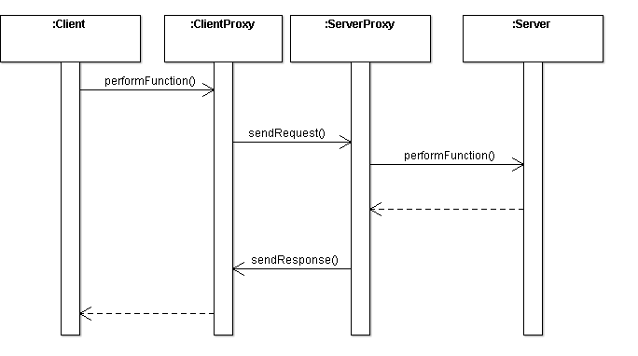
Scenario 1
The client simply invoke performFunction() on the client proxy as if it were a local call
It has no impact at all to the client even when it is changed
locateServer()
marshal()
marshal()
locateServer()
unmarshal()
Works well, but you can’t change the server location at run-time

Slide 12
Broker as service locator
Broker resides at a well-known location and then expose that location to the client
Broker is responsible for locating the server for the client.
Broker also implements a repository for
adding and removing server components
Makes it possible to add, remove, or exchange server components at run time
Once the server is located, client and server talks directly

Slide 13
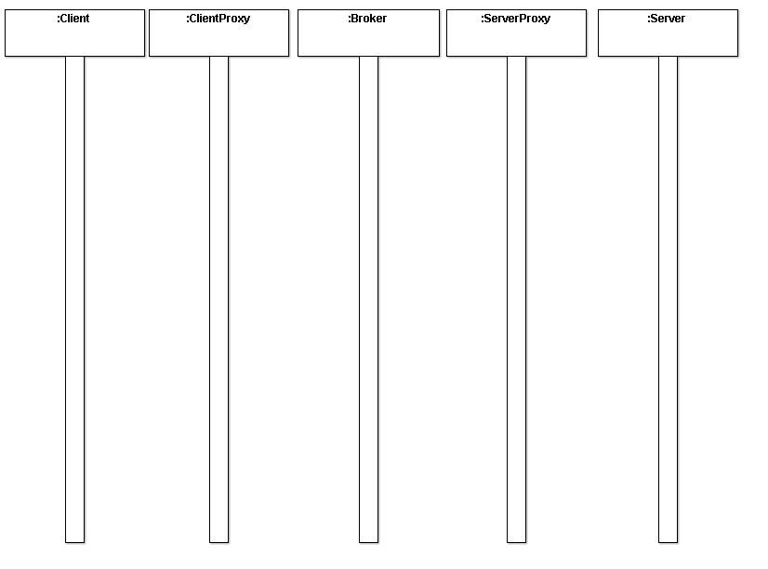
Broker behavior server look-up
performFunction()
locateServer()
registerServer()
marshal()
sendRequest()
unmarshal()
performFunction()
locateClient()
marshal()
sendResponse()
unmarshal()

Slide 14
Broker as Intermediary
In some situations, direct communication between client and server is not desirable
For security reasons you may want to host all the servers in your company's private network, behind a firewall, and
only allow access to them from the broker
Broker forwards all the requests and responses between the server and the client instead of direct communication

Slide 15
Broker as intermediary
performFunction()
registerServer()
marshal()
sendRequest()
locateServer()
forwardRequest()
unmarshal()
performFunction()
sendResponse()
marshal()
forwardResponse()
locateClient()
unmarshal()

Slide 16
Broker Known Uses- CORBA
CORBA is the oldest amongst the middleware technologies used in today’s IT world
CORBA stands for Common Object Request Broker Architecture and is defined by
its interfaces
their semantics and
protocols used for communication (Internet Inter-Orb Protocol IIOP)
CORBA supports the basic Broker pattern.
For the basic functionality CORBA supports the so called Dynamic Invocation Interface (DII) on the client-side
From IDL both client proxy (client stub) and the server proxy (called skeleton)
Various ORB extensions support a wide variety of advanced features
CORBA supports client-side asynchrony via standardized interface. Server-side asynchrony is only supported proprietarily.

Slide 17
Broker Known Uses- RMI
Sun's Java Remote Method Invocation (RMI) is based on the Transparent Broker variant pattern
The client-side proxy (so called stub) and the server-side invoker (so called skeleton) have to be created manually by an additional compilation step
In contrast to CORBA the ServiceInterface is not written in an abstract IDL, but in Java.
RMI is limited to the usage of Java
To establish interoperability RMI-IIOP is provided
RMI doesn't support client-side or server-side asynchrony out of the box- you have to implement
A central naming service (so called RMI registry) allows clients to look up servant identifiers

Slide 18
Broker Known Uses- .NET
Microsoft's .NET Remoting platform implements the Transparent Broker variant pattern to handle remote communication.
Since the .NET platform supports reflection to acquire type information, the client proxy is created automatically at runtime behind the scene, completely transparent for the application developer.
No separate source code generation or compilation step required.
The interface description for the client proxy can be provided by MSIL-Code or by a WSDL-Description of the interface itself.
The client proxy is responsible of creating the invocation request, but is not in charge of any communication related aspects.
The remote communication functionality of .NET Remoting is encapsulated within a framework consisting of marshalers (so called Formatters in .NET Remoting) and Transport Channels, which abstract from the underlying transport layer.
Flexible, allows any custom extensions to fulfil for example QoS requirements.
Supports the client-side asynchrony broker variants. Lifecycle management strategies for servants are also included within the framework.
Doesn't have a central naming or lookup system. Clients have to know the object reference of the servant in advance. However different strategies exist to avoid the hardcoding of the server destination inside the client application code

Slide 19
Benefits
Location Independence-- Clients do not have to care where an object is located, though for remote objects, they always have to use the more complex interface, unless a Transparent Broker is used.
Type System Transparency—Differences in type systems are coped with by a intermediate network protocol. The marshaler translates between programming language specific types and the common network protocol.
Isolation-- Separating all the communication-related code into its own layer isolates it from the application. You can decide to run the application distributed or all on one computer without having to change any application code.
Separation of Concerns —The communication and marshaling concerns are properly encapsulated in the requestor, invoker, and marshaler.
Resource Management—The management of network and other communication resources such as connections, transfer buffers and threads is encapsulated within the Broker Participants and therefore seperated from the application logic.
Portability —Platform dependencies which typically arise from low level I/O and IP communication are encapsulated within the Broker Participants and therefore separated from the application logic.

Slide 20
Liabilities
Error Handling—Clients have to cope with the inherent unreliability and the associated errors of network communication.
Overhead —Developers can easily forget about the location of objects, which can cause overhead if the expenses of remote communication are not considered
Performance
Lower fault tolerance (server fails, broker fails, ...)
Testing and debugging

Slide 21
Model View Controller
Architecture Patterns-- Interactive Patterns

Slide 22
The Need: Example
You are going to build a web-based software application for this example
Grade A: 5
Grade B: 15
Grade C: 50
Grade D: 25
Grade F: 5
Grade | % of Students
A | 5
B | 15
C | 50
D | 25
F | 5
Such an application typically retrieves data and displays it for the user.
After the user changes the data, the system stores the updates in the data store.

Slide 23
Context and Problem
Context
Interactive application with flexible human-computer interface
Problem
Because the flow of information is between the data store and UI, one may be inclined to data and UI to reduce the amount of coding and to improve application performance.
However, the major problem is that UI tends to change much more frequently than the data storage system.
Another problem is that business applications tend to incorporate complex business logic which also gets mixed up

Slide 24
Forces
Same data with different presentation needed
Display, behavior and data-manipulation to be reflected immediately
UI is a different element altogether
Changes are very frequent, more than data and business logic
One should be able to test only the UI part
Skillset: HTML page designer skills are different from core app development. It is desirable to separate UI with the rest of the app
Changing look-feel (even device dependency) shouldn’t affect the core app
In web-app, one UI action can trigger many processing and then outcome may need to be collated into one

Slide 25
Model View Controller
Event
Event (keyboard, mouse) passed to the Controller
Multiple Controllers possible.
Each controller interprets input events and takes action
Controller
Controller
View
View
Multiple Views
Each view manages display of information
Model
Captures data
Sends data to View
Responds to Controller for changing data

Slide 26
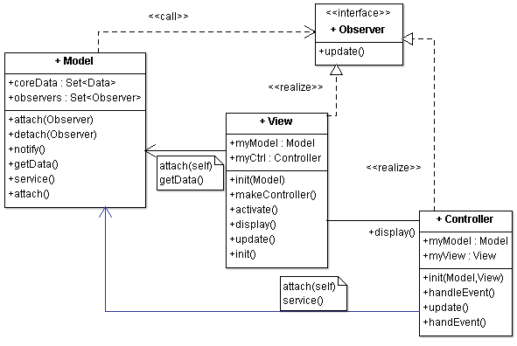
Model-View-Controller
User makes change in UI, which comes to controller
Controller interprets the change, informs model for the change
Model makes change in data
Model notifies all the relevant views regarding the change
View gets latest data and updates the display

Slide 27
To be continued…..

